Slide 1
Appendixes
Computer Science: An Overview
Tenth Edition
by
J. Glenn Brookshear

Slide 2
Appendix A: Samples from ASCII
Symbol ASCII Symbol ASCII
A 01000001 0 00110000
B 01000010 1 00110001
C 01000011 2 00110010
a 01100001 # 00100011
b 01100010 . 00101110
c 01100011 line feed 00001010

Slide 3
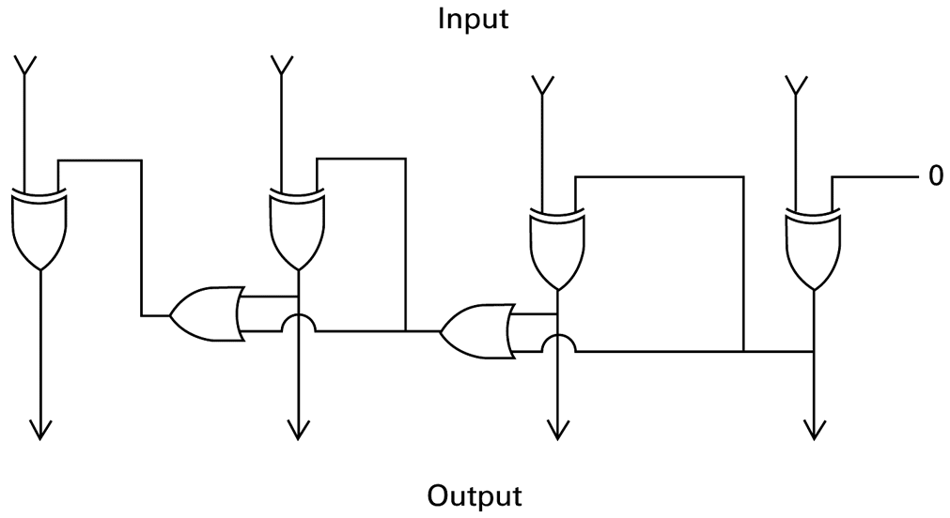
Figure B.1 A circuit that negates a two’s complement pattern

Slide 4
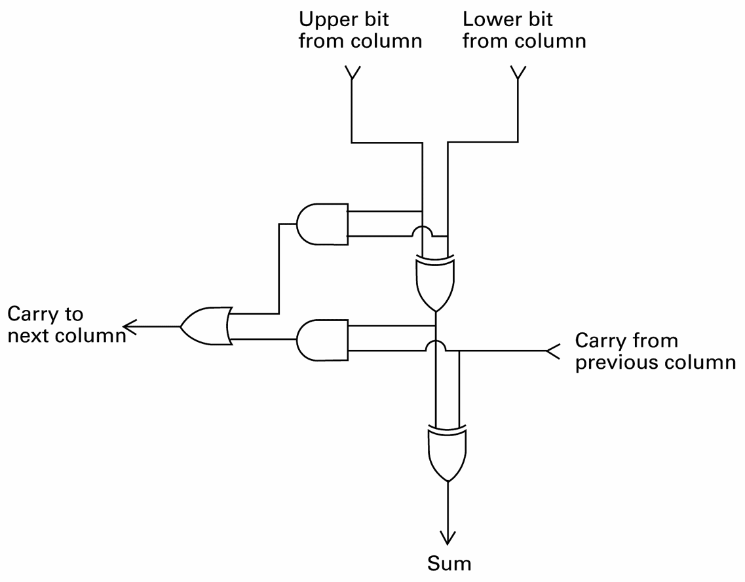
Figure B.2 A circuit to add a single column

Slide 5
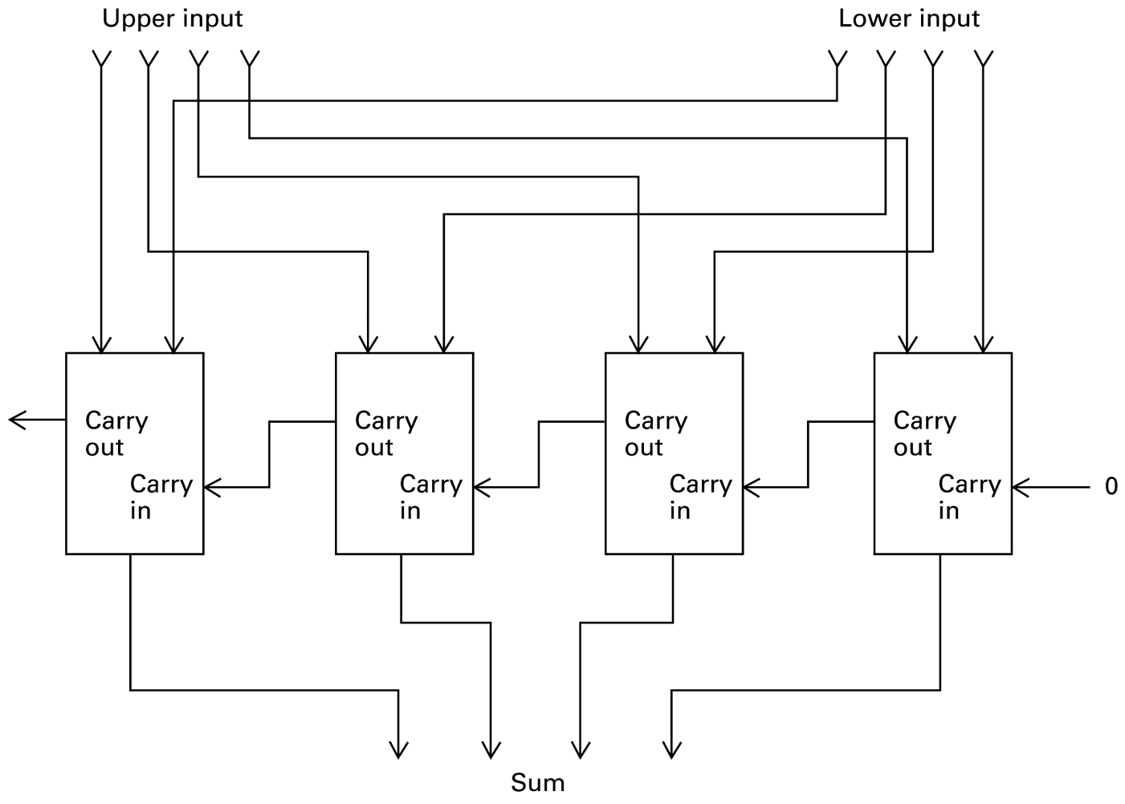
Figure B.3 A circuit for adding two’s complement values

Slide 6
Appendix C: A Simple Machine Language
Op-code Operand Description
1 RXY LOAD reg. R from cell XY.
2 RXY LOAD reg. R with XY.
3 RXY STORE reg. R at XY.
4 0RS MOVE R to S.
5 RST ADD S and T into R. (2’s comp.)
6 RST ADD S and T into R. (floating pt.)

Slide 7
Appendix C: A Simple Machine Language (continued)
Op-code Operand Description
7 RST OR S and T into R.
8 RST AND S and T into R.
9 RST XOR S and T into R.
A R0X ROTATE reg. R X times.
B RXY JUMP to XY if R = reg. 0.
C 000 HALT.

